Slide 1
1/15/21 optical truss sideband locking

Slide 2
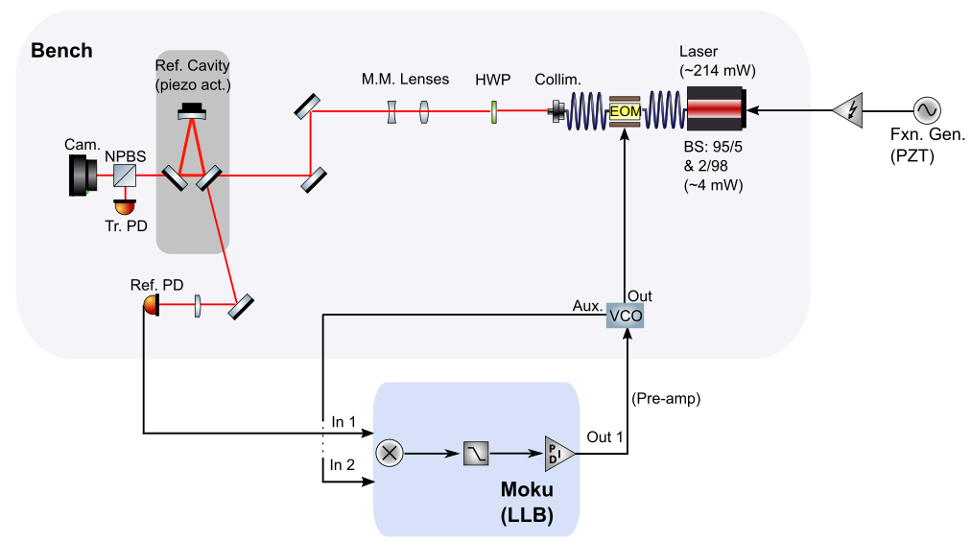
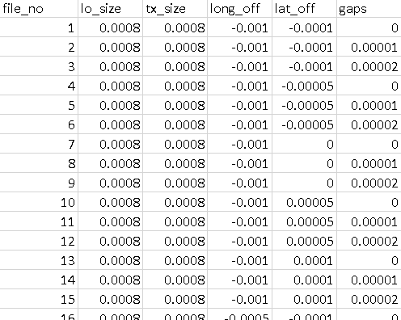
Optimizing sideband lock / simulations parameter space

Slide 3
plans
Perform more accurate open-loop gain measurement
Increase range of amplification stage (still overloads)
Measure noise, compare for PDH and other sideband locks

